Slide 1


SMART INDIA HACKATHON 2026
Problem Statement ID – SIH26107
Problem Statement Title- AI-powered Intelligent Assistant for Indian Standards and BIS Services for Industries and Consumers
Theme- Smart Automation
PS Category- Software
Team ID- SIH26-A0H-T263
Team Name- Byte Busters

Slide 2

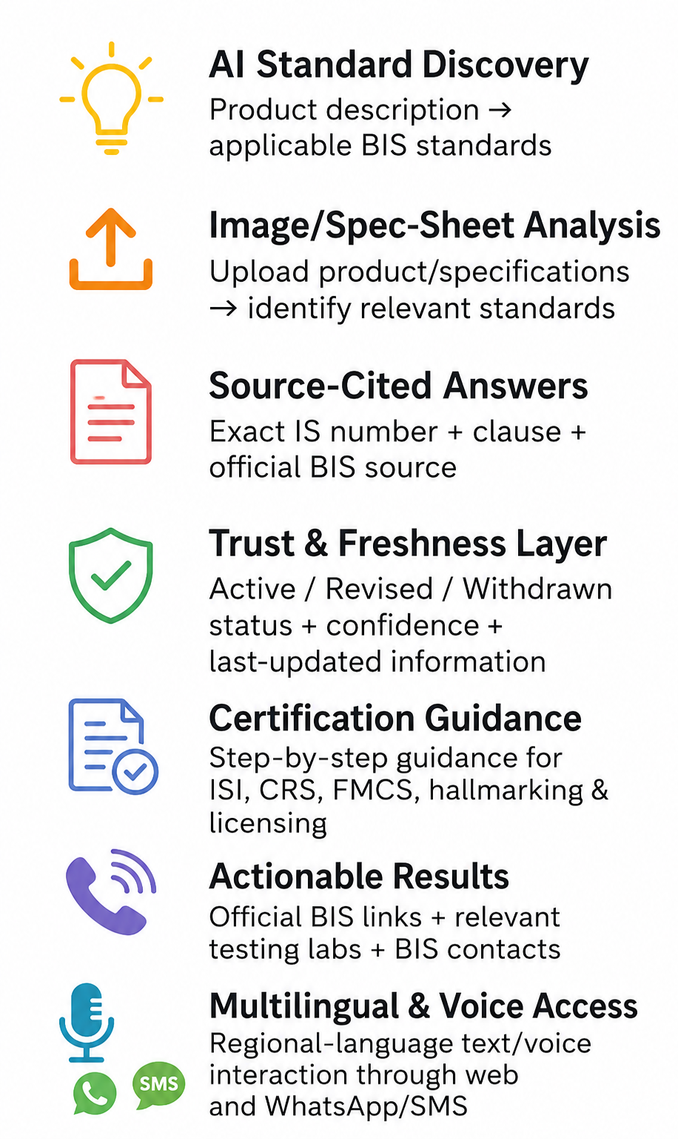
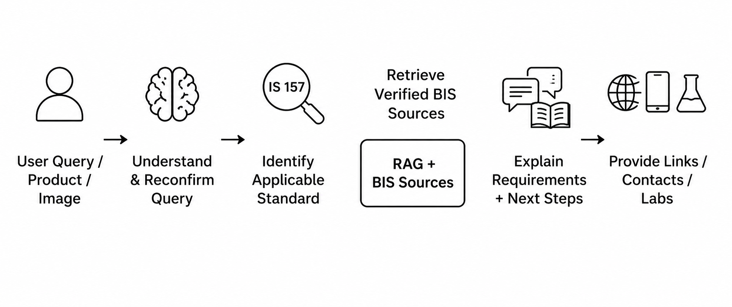
IDEA TITLE
Major Problems
Our Solution & Working
Key Features
Fragmented Information
BIS standards, certification, licensing and testing info are spread across multiple portals.
A multilingual, source-grounded AI assistant that turns scattered BIS standards and certification rules into one trusted conversation.
What it does:
Difficult Standard Discovery
Users struggle to identify the correct Indian Standard from a product description or spec
• Matches a description, voice query, or spec sheet to the correct Indian Standard
• Guides step-by-step certification (ISI / CRS / FMCS)
• Verifies BIS marks and live license status
• Attaches source link, last-updated date, and a real time contact to every answer
Complex Certification Process
Certification, testing and scheme requirements often need manual interpretation or outside help
• Escalates low-confidence answers to the BIS helpline
Methodology used:
• RAG over BIS's Know Your Standard, CRS, and licensing portals — every answer is source-grounded
Accessibility Gap
Technical BIS information isn't easily accessible in regional languages, voice, or conversational form
• Confidence scoring — triggers human escalation below a threshold
• Multilingual NLP (IndicTrans 2) for Indian-language text and voice
• Vision/OCR for spec-sheet and image uploads
How it Works ?
Trust & Freshness Issues
Users need assurance that answers reference current, applicable standards — not outdated ones

Slide 3
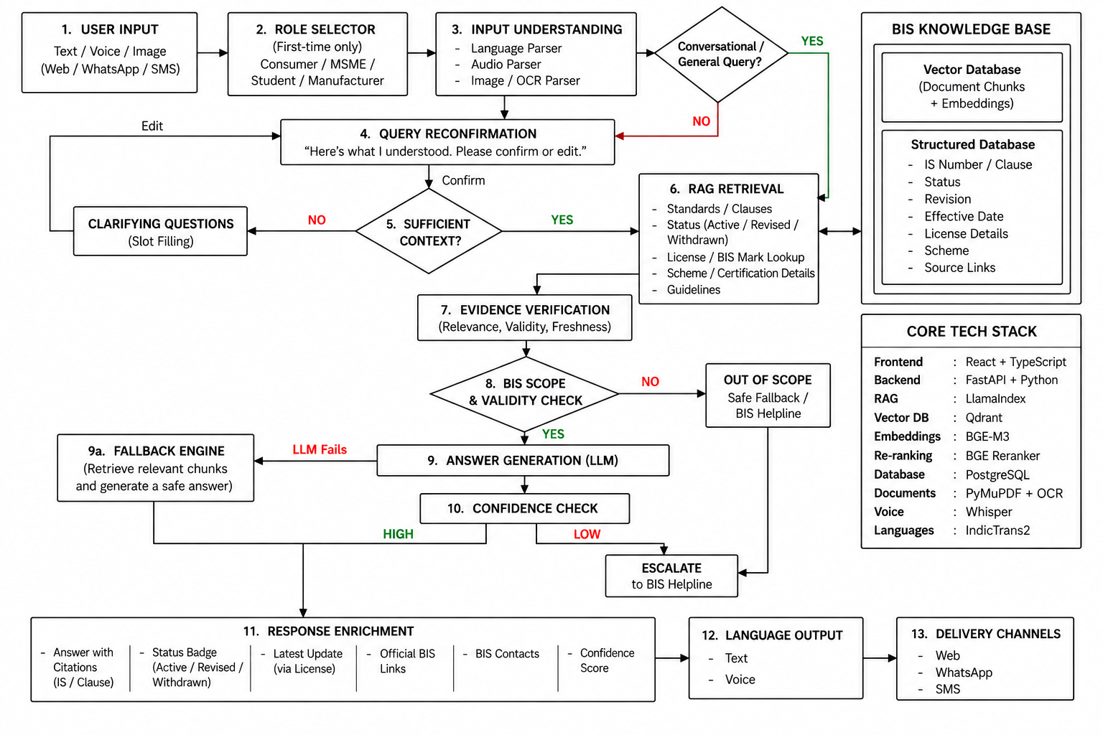
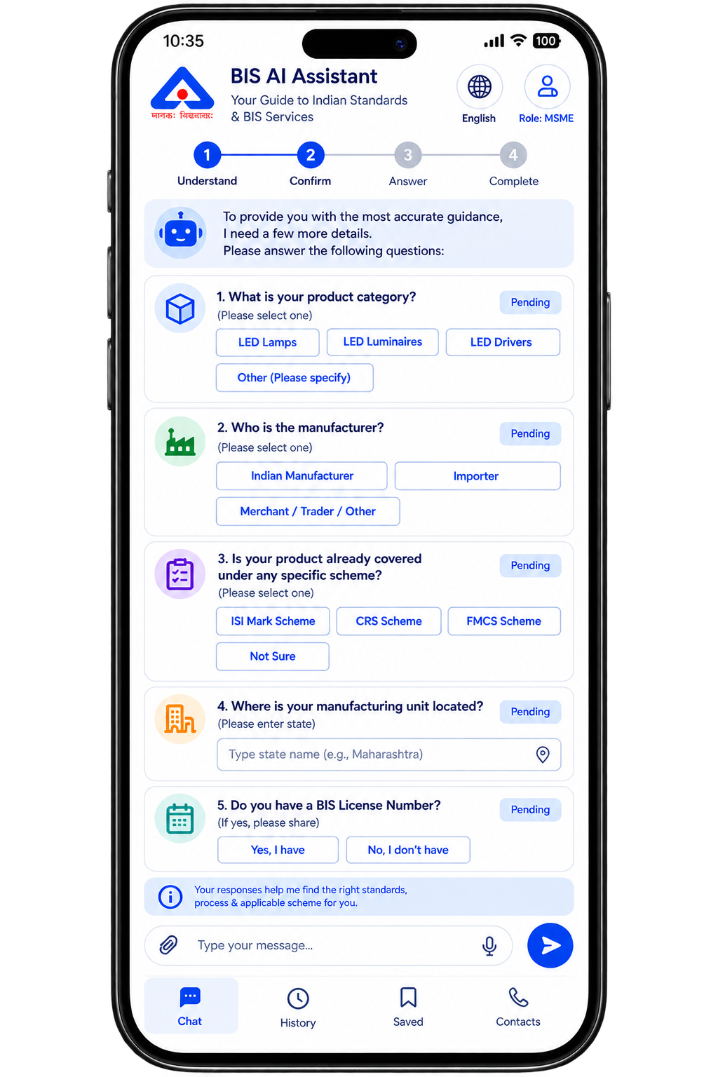
TECHNICAL APPROACH
Clarification Flow

Slide 4






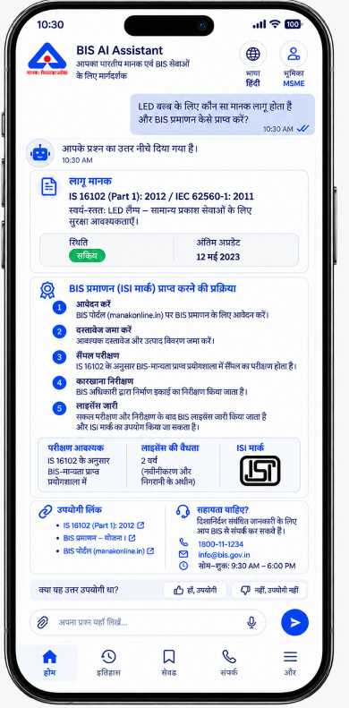
FEASIBILITY AND VIABILITY
FEASIBILITY & VIABILITY PILLARS
MULTILINGUAL SUPPORT
1. TECHNICAL FEASIBILITY
2. DATA & AI FEASIBILITY
3. ECONOMIC VIABILITY
4. OPERATIONAL VIABILITY
5. SOCIAL & ACCESSIBILITY
SECURITY, LEGAL & TRUST
RAG pipeline with OCR/vision parsing on FastAPI + Postgresql
Knowledge base from official BIS sources, with status and revision tracking.
Open-source AI infrastructure reduces licensing costs; one backend supports multiple channels.
One backend supports Web, WhatsApp and SMS; clarification is requested only when required.
Multilingual text/voice via IndicTrans 2, over WhatsApp/SMS — no new app.
RBAC, encryption, API protection and secrets management safeguard user data, AI services and system access.
POTENTIAL CHALLENGES AND RISKS
STRATEGIES FOR OVERCOMING THESE CHALLENGES
BIS DATA CHANGES
AI HALLUCINATION
FRESHNESS & STATUS CHECK
GROUNDED, CITED RAG
Standards get revised or withdrawn — stale answers mislead users.
A confident-looking wrong answer carries real legal risk.
Answers restricted to retrieved BIS text, with citation and confidence score.
Live status badge and last-updated date, via license lookups.
COPYRIGHTED STANDARD TEXT
MULTILINGUAL ACCURACY
SCOPED, LICENSED INGESTION
TRANSLATION VALIDATION
Full IS text is copyrighted, not freely scrapable at scale.
Hindi/Hinglish queries confuse translation; terms rarely map 1:1.
Scoped to compulsory-certification categories, via BIS's free-download facility.
IndicTrans 2 preserves technical terms; reconfirmation confirms intent first.

Slide 5
IMPACT AND BENEFITS
UNIQUE FEATURES
IMPACTS
License-Linked Freshness
Consumer Trust & Safety
MSME Compliance Speed
Digital Inclusion
Less Counterfeit Circulation
Institutional Visibility
Every answer shows the regulation / last-updated date tied to its license number.
Licence and mark checks help users identify potentially invalid certification information.
Reduces time spent searching across standards, schemes and certification requirements.
Voice and regional-language interaction makes BIS information easier to access.
Real-time status badges flag withdrawn standards and fake marks fast.
Query analytics reveal common compliance gaps and information bottlenecks.
Reachable Official Links
Direct links to the official BIS portal — not just bot-generated text.
Confidence-Scored Answers
Users see how certain the AI is before they act on it.
BENEFITS
Faster Certification Cycles
Reduced Compliance Errors
Lighter Helpline Load
One Backend, Every Channel
Scalable Operations
Role-Aware Personalization
Role Selector (Consumer / MSME / Student / Manufacturer) tailors each answer's depth and next steps.
Step-by-step guidance + instant standard-matching gets products to market sooner.
Clear standard identification helps avoid incorrect certification paths.
Routine questions are handled automatically; complex cases are escalated.
Web, WhatsApp, and SMS all run off the same engine — no rebuilds.
Supports large query volumes without proportional growth in manual support.
Guideline-Query Contacts
BIS contact details auto-attached whenever a guideline question is asked.

Slide 6


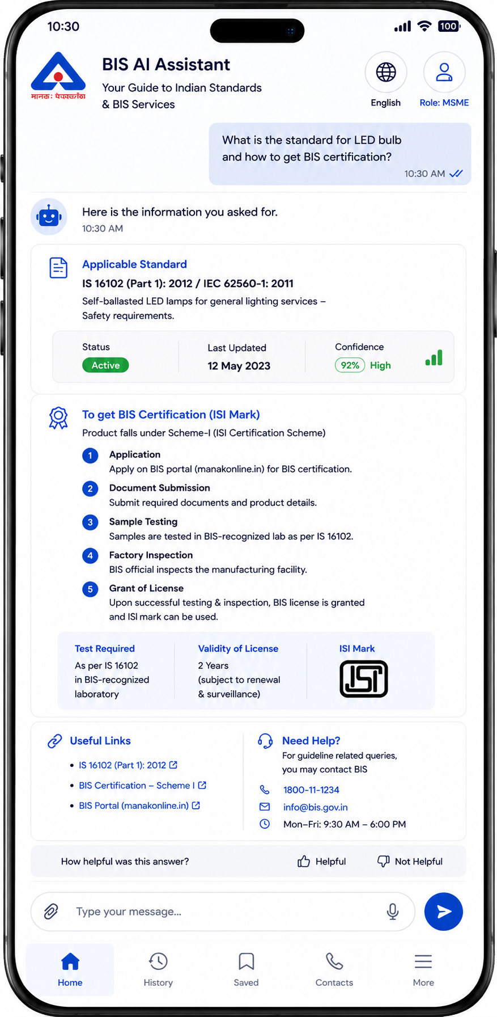



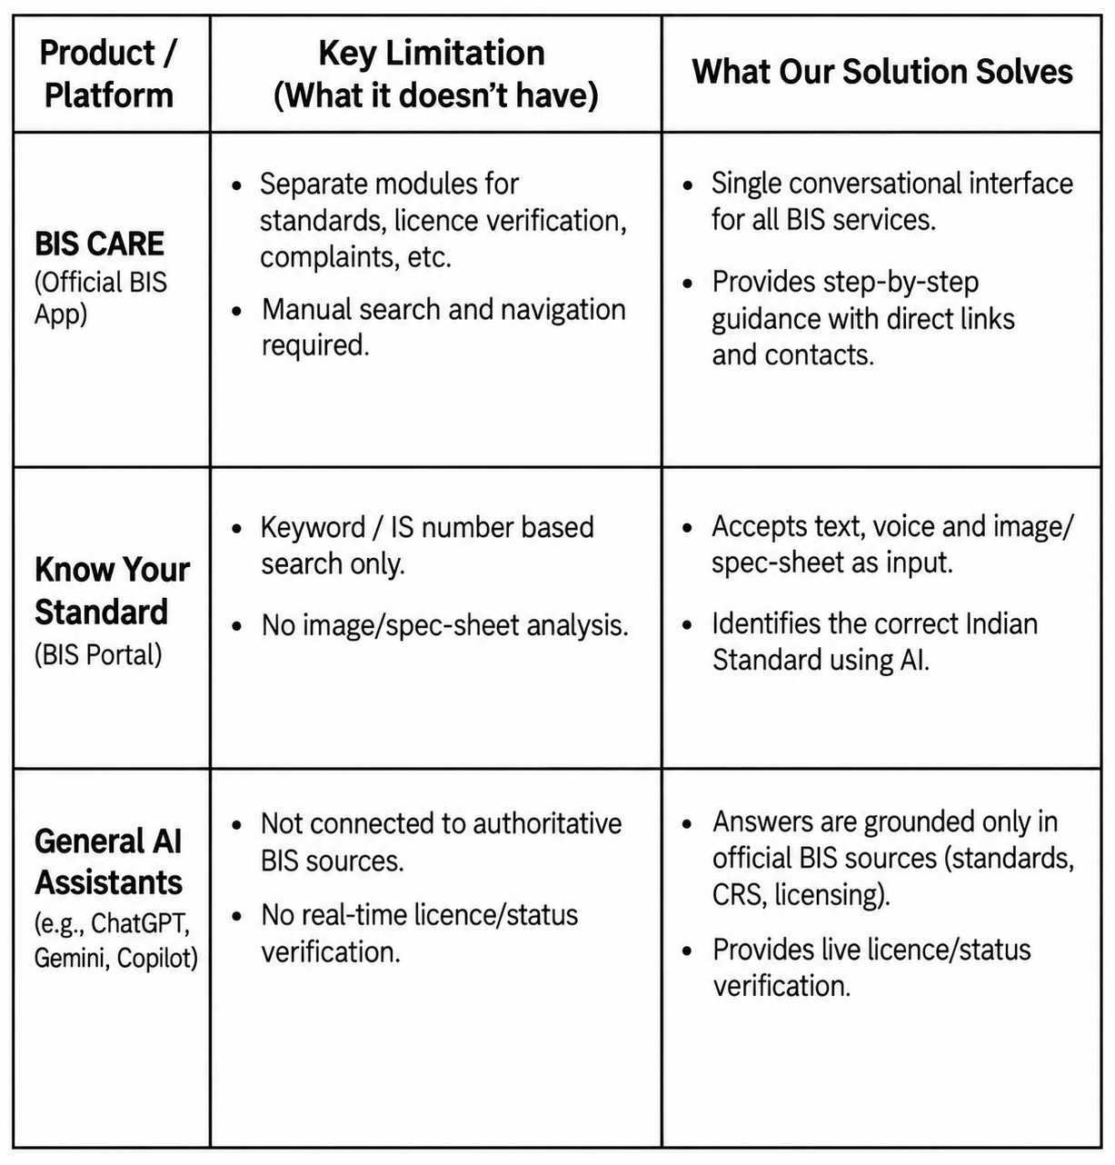


SDG 9
APP INTERFACE
Retrieval-Augmented Generation (RAG)
Summary: Pairs a language model with a retriever over an external index, grounding answers in retrieved passages rather than model memory alone.
Link: arxiv.org/abs/2005.11401
Target 9.1 — Access to Quality Infrastructure: Makes BIS technical information searchable in plain language.
Target 9.3 — MSME Market Access: Simplifies ISI/CRS certification guidance for small manufacturers.
Target 9.b — Indigenous Tech Capacity: Uses IndicTrans 2 (AI4Bharat) for Indian-language AI support.
Target 9.5 — Innovation in Public Infrastructure: Applies RAG-based AI to a government knowledge base.
Self-RAG (Self-Reflective Retrieval)
Summary: Trains a model to judge when retrieval is needed and critique its own drafts against retrieved text, cutting hallucinated claims.
Link: arxiv.org/abs/2310.11511
BIS ‘Know Your Standard’ Portal
Summary: BIS's official lookup for any IS number or product keyword, showing scope, status and related documents.
Link: bis.gov.in/know-your-standard
IndicTrans2 (AI4Bharat)
Summary: Open-source translation system covering all 22 scheduled Indian languages, built by AI4Bharat (IIT Madras).
Link: github.com/AI4Bharat/IndicTrans2
Why Our Product?
BIS Compulsory Registration Scheme (CRS)
Summary: Official portal for BIS's CRS scheme on notified electronics/IT products, covering rules and license status.
Link: crsbis.in
Quadrant Vector Database
Summary: Open source embedding database for LLM apps, storing text chunks with embeddings for similarity search.
Link: qdrant.tech/documentation

